Slide 1

Thesis Project
25.9.2026
Manuel Mazzara

Slide 2
Agenda
Part 1: Time Machine
Part 2: Roll up your sleeves
Part 3: Motivation
Part 4: Questions and Answers

Slide 3
What is a thesis?
An academic thesis is an original research document submitted to fulfil the requirements for an academic degree (BS, MS, PhD)
The term dissertation is often used to indicate a PhD written thesis

Slide 4
Etymology
Thesis comes from Greek (θέσις): "something put forth“
  an intellectual proposition
Dissertation comes from Latin (dissertātiō): "discussion".
“A 'thesis' is a supposition of some eminent philosopher that conflicts with the general opinion ... for to take notice when any ordinary person expresses views contrary to men's usual” (The Works of Aristotle. Vol. 1. Oxford: Clarendon Press)
For Aristotle a thesis was a supposition stated in contradiction with general opinion or expressing disagreement with other philosophers

Slide 5
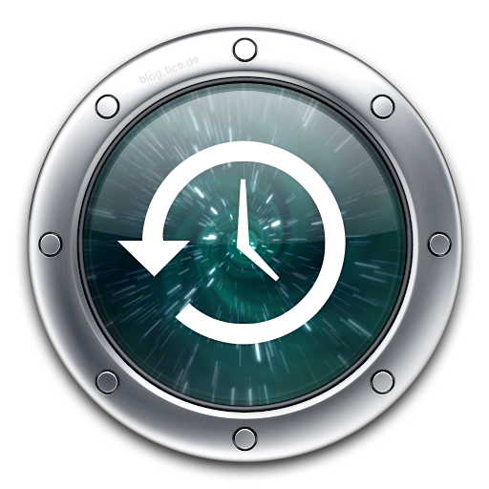
Part 1: Time Machine

Slide 6
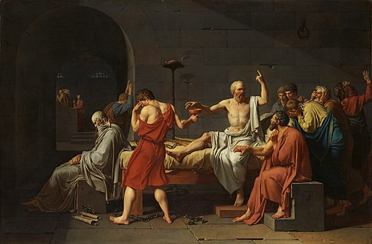
The Death of Socrates - Jacques-Louis David (1787)

Slide 7
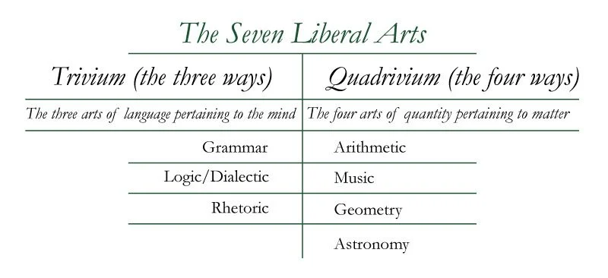
The seven classic liberal arts

Slide 8
Trivium and quadrivium
The seven classical liberal arts were foundational to Western education until the Renaissance (14th century)
The trivium: language and argument
The quadrivium mathematical and scientific reasoning
  a structured path for intellectual development

Slide 9
Middle-age: thesis
Medieval European universities (12th-13th centuries)
  Not a written document but a public oral examination
A student would publicly defend a set of propositions (these) against challengers
  This would demonstrate their mastery of existing knowledge and skill in logical argument

Slide 10
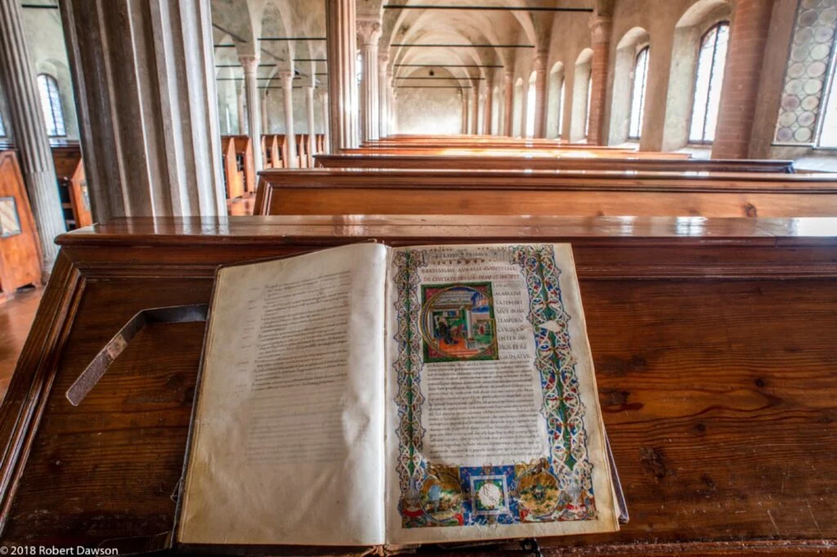

Slide 11
From oral to written
The oral defence remained, supported by a written dissertation served as the basis for the disputation (17th and 18th centuries)
In German universities, this evolved into the requirement for an Inauguraldissertation—a substantial written work submitted for examination prior to the oral defence, marking a key shift toward valuing the permanent, written record of scholarship

Slide 12
The modern thesis
Mostly shaped in 19th-century German universities
An original contribution to knowledge, essential for the research doctorate (PhD)
This model emphasized empirical investigation and the creation of new knowledge, not just the synthesis of existing ideas

Slide 13
From Germany to USA
The German research-focused PhD model was widely adopted, most notably in the United States
  Johns Hopkins University in 1876, considered the first research university in the United States
The thesis (especially the doctoral dissertation) was established as a global standard for awarding advanced degrees
Hence the appearance of a standard structure into chapters (Introduction, Literature Review, Methodology…)

Slide 14
20th and 21st centuries
In the 20th century, this practice was extended and established to lower degrees
This allowed students at all levels to engage in independent research, though the expectation of originality was scaled to their experience
In 21st century, submission, archiving, and dissemination are primarily electronic through online repositors
  increased accessibility, inclusion of non-textual media, and promoted the principles of open access to scholarly research

Slide 15
Academic degrees in Russia
Russian empire
  Moscow University (1755): Lomonosov advocated for a system of academic degrees modelled on those of Western Europe
  Granted scientists noble status and made academic pursuit a path to social advancement
Post-revolution
  In 1918, all academic degrees and titles were abolished to eliminate class privileges, and then restored in 1934 with changes
  Candidate of Sciences vs Doctor of Sciences, the two-tiered structure that defines the system today
A blend of adopted European models and unique adaptations

Slide 16
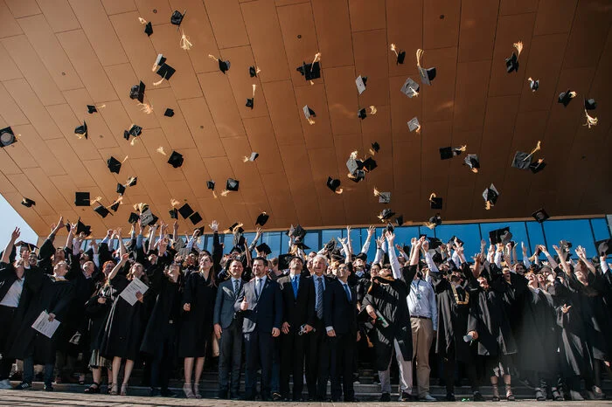

Slide 17

Part 2: Roll up your sleeves

Slide 18
Step 1: find a supervisor
It is a competitive process: many students and few supervisors
  Act as early as possible (typically April-May is the right time to act)
  If you haven’t found one, you are already very late
  Proactivity is expected, this activity is very different from anything else you have done before
How to choose a supervisor?
  Two main criteria: research interests and personal affinity
  Make a short list of potential supervisors based on these criteria and contact them in person, email, telegram…
  It is highly recommended to come already with a research proposal

Slide 19
Step 2: completing a research proposal
It is preferable to have a draft before meeting potential supervisors
  After the meeting, you will have to elaborate further
  First draft can be 4-5 pages
What the proposal should contain (at least)?
  Introduction and research problem
  Research questions
  Novelty and contributions
  State-of-the-Art (early draft of literature review)
  Goal of the Thesis
  Detailed Work Plan and schedule (at least by month)
  References

Slide 20
Step 3: agreeing with a supervisor
It may take some communication and a couple of meetings over 1-2 weeks
It may take some editing of the proposal
Not all the supervisors follow exactly the same approach, some are more strict, some less
When you have an agreement you can start working

Slide 21
You must find a supervisor and have a topic by :
Bachelors: October 12th
Masters: October 19th

Slide 22
Step 4: supervision style
Set clear mutual expectations
  What do you expect from him/her?
  What he/she should expect from you?
Define whether a co-supervisor is needed or not and how will you work with the co-supervisor
  The co-supervisor does not replace all the functions of the supervisor
Define with your supervisor a communication and supervision style
  Push vs pull (who is searching who?)
  Remote vs in presence (where will you meet?)
  Internal timelines (when will you meet?)
  Internal milestones (what will you share?)
  Common Instruments (how will you deliver?)

Slide 23
Step 5: work hard for your first submission
From now on the interaction with your supervisor(s) will be very personal and mutually clear
Moodle is the tool for the official submissions
Work on your Chapter 1 (Introduction) and Chapter 2 (Literature review) according to the indications of your supervisor
  Vast literature on how to write this part exist (you can also contact me and I will share some)

Slide 24
You must submit your first two chapters by:
Bachelors: November 1st
Masters: December 10th

Slide 25

Part 3: Motivation

Slide 26
What benefits will I get from working hard? (1)
Practice to discipline
  Begin involved in a significant project of mid-size
Writing your (possibly) first research from scratch
  Maybe getting published
  Gain some visibility in your field
Learn how to manage a large amount of literature

Slide 27
What benefits will I get from working hard? (2)
Increase your CV with several lines
  More technologies
  Writing skills
  Research/analysis skills
Extend your networking
  You will know more people and some will get in touch with you later
Valuable memories
  Memories in life stay longer than any other tangible possession

Slide 28
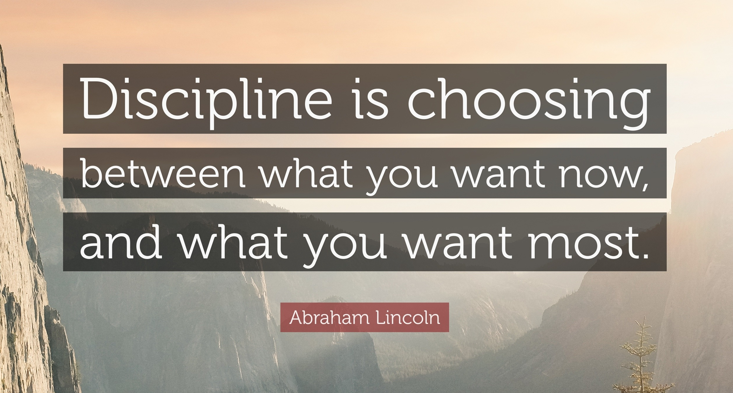

Slide 29
Part 4: Questions and Answers

